Slide 1

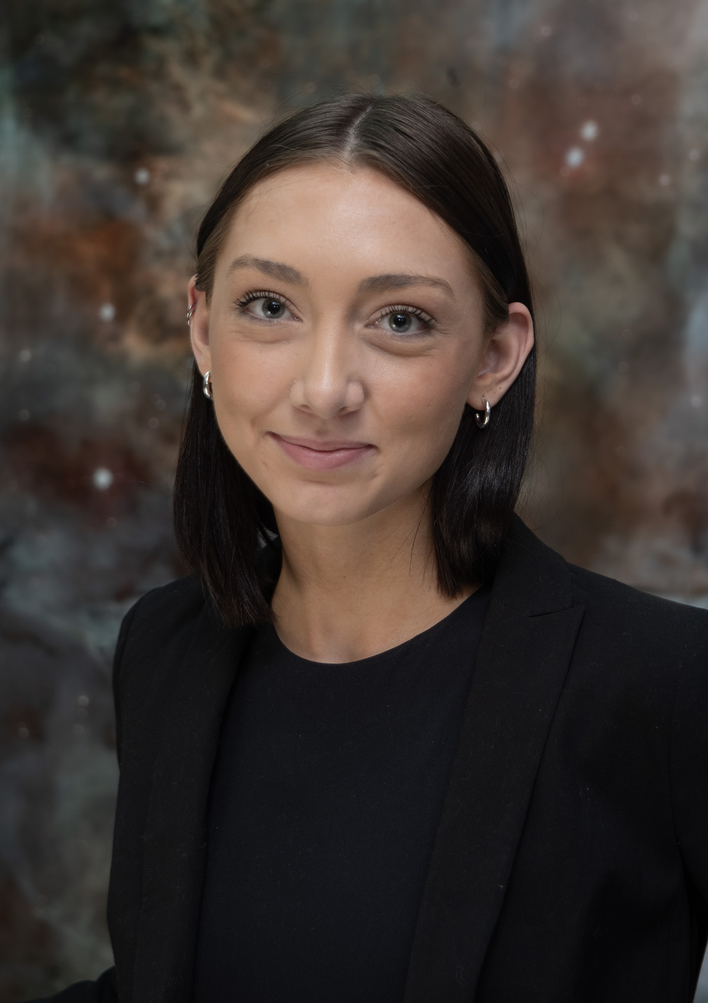
What’s it like to work at NASA?
Ally Payne

Slide 2
Topics
My job at NASA
How I got here
A day in the life (+ pictures)
Modeling work using PSG
My personal science results
What is NASA doing right now?
Questions

Slide 3
My Job: Post Baccalaureate Research Scientist
SURA/ CRESST II
Typically a one-year role working directly with a NASA scientist/ civil servant
Generally allows time for more research experience/ a chance to take part in a research institute prior to 5-7 years in a PhD program
Great opportunity for making career connections too
Opportunities for career development & help applying to grad programs
Hybrid/ Flexible Schedule

Slide 4
How I got here: My Path
High School: Silverdale, WA
Very involved in extracurriculars (clubs/ leadership, tennis), maintaining good grades, applying to as many scholarships as possible, AP classes
Needed to fund my own education
University of Washington, Seattle, WA
Triple Major: Physics, Astronomy, Earth and Space Sciences (physics track)
Involved in astronomy research: CGM/ galaxies, exoplanets, summer projects
NASA: Greenbelt, Maryland
Career and grad school prep work

Slide 5
A realistic day in the life
9:30 AM – emails, coffee, work on paper
11 AM – go for a walk, call family
11:30 AM –work on paper
1 PM - lunch, go outside
1:45 PM – work on paper
4 PM – head home, take a break, eat food
9 PM – do a bit of work before sleeping
Some days you will work more than others!

Slide 6
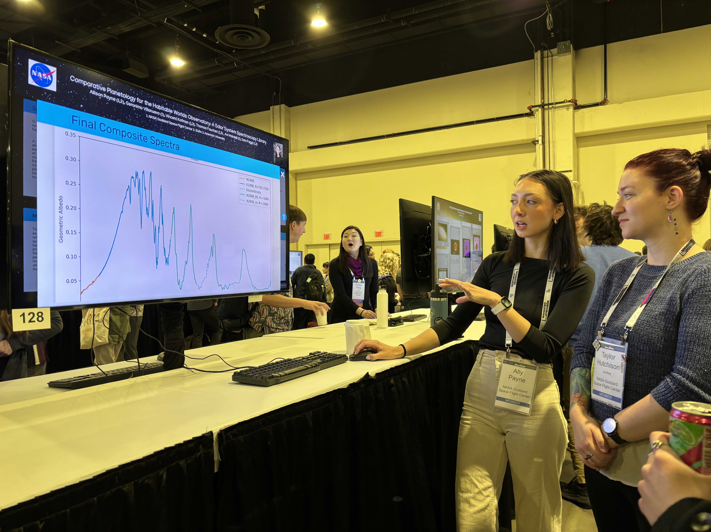
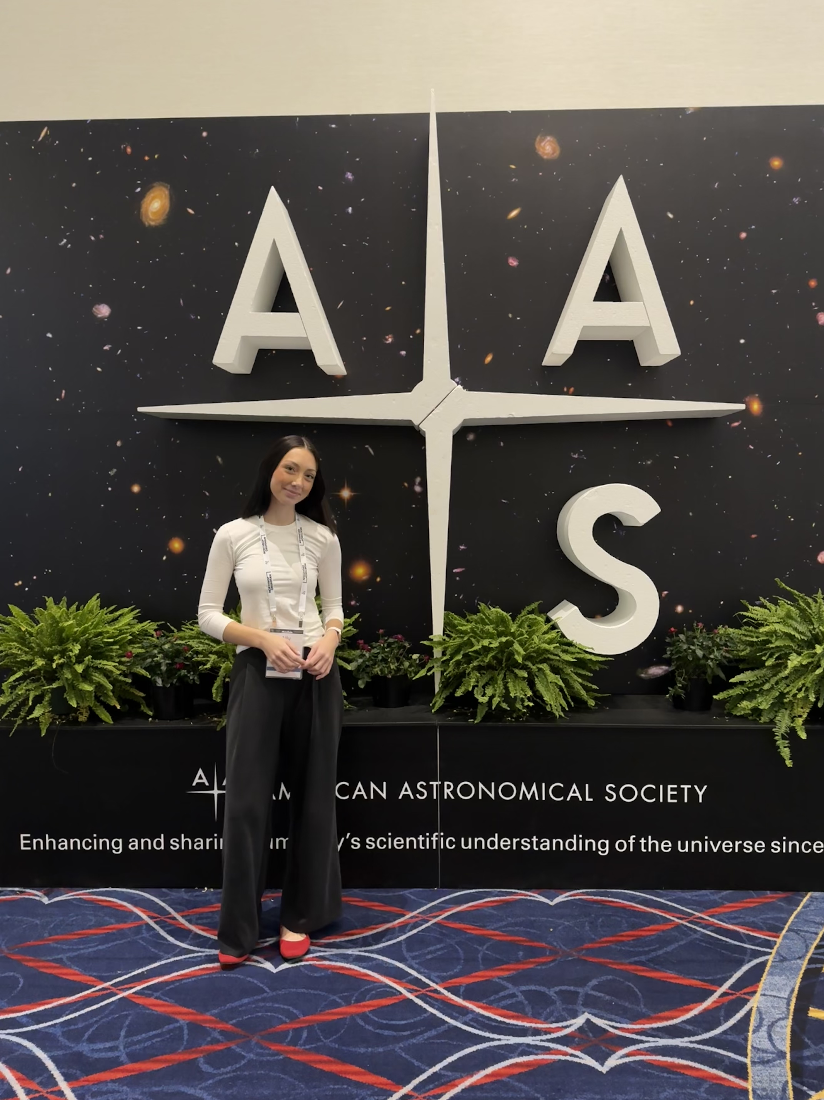
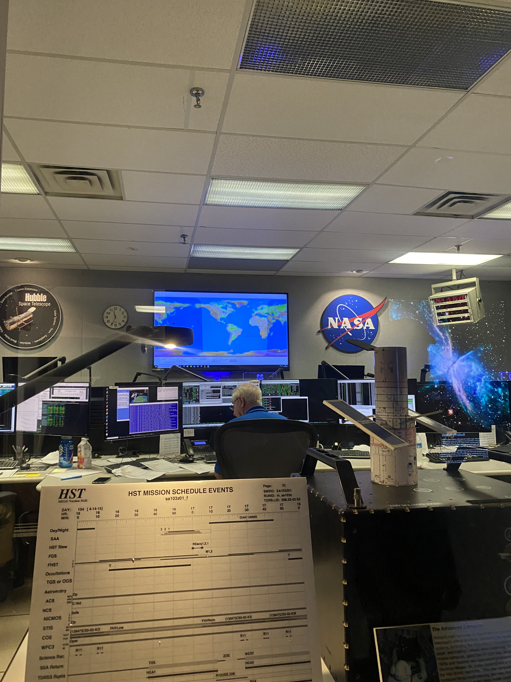
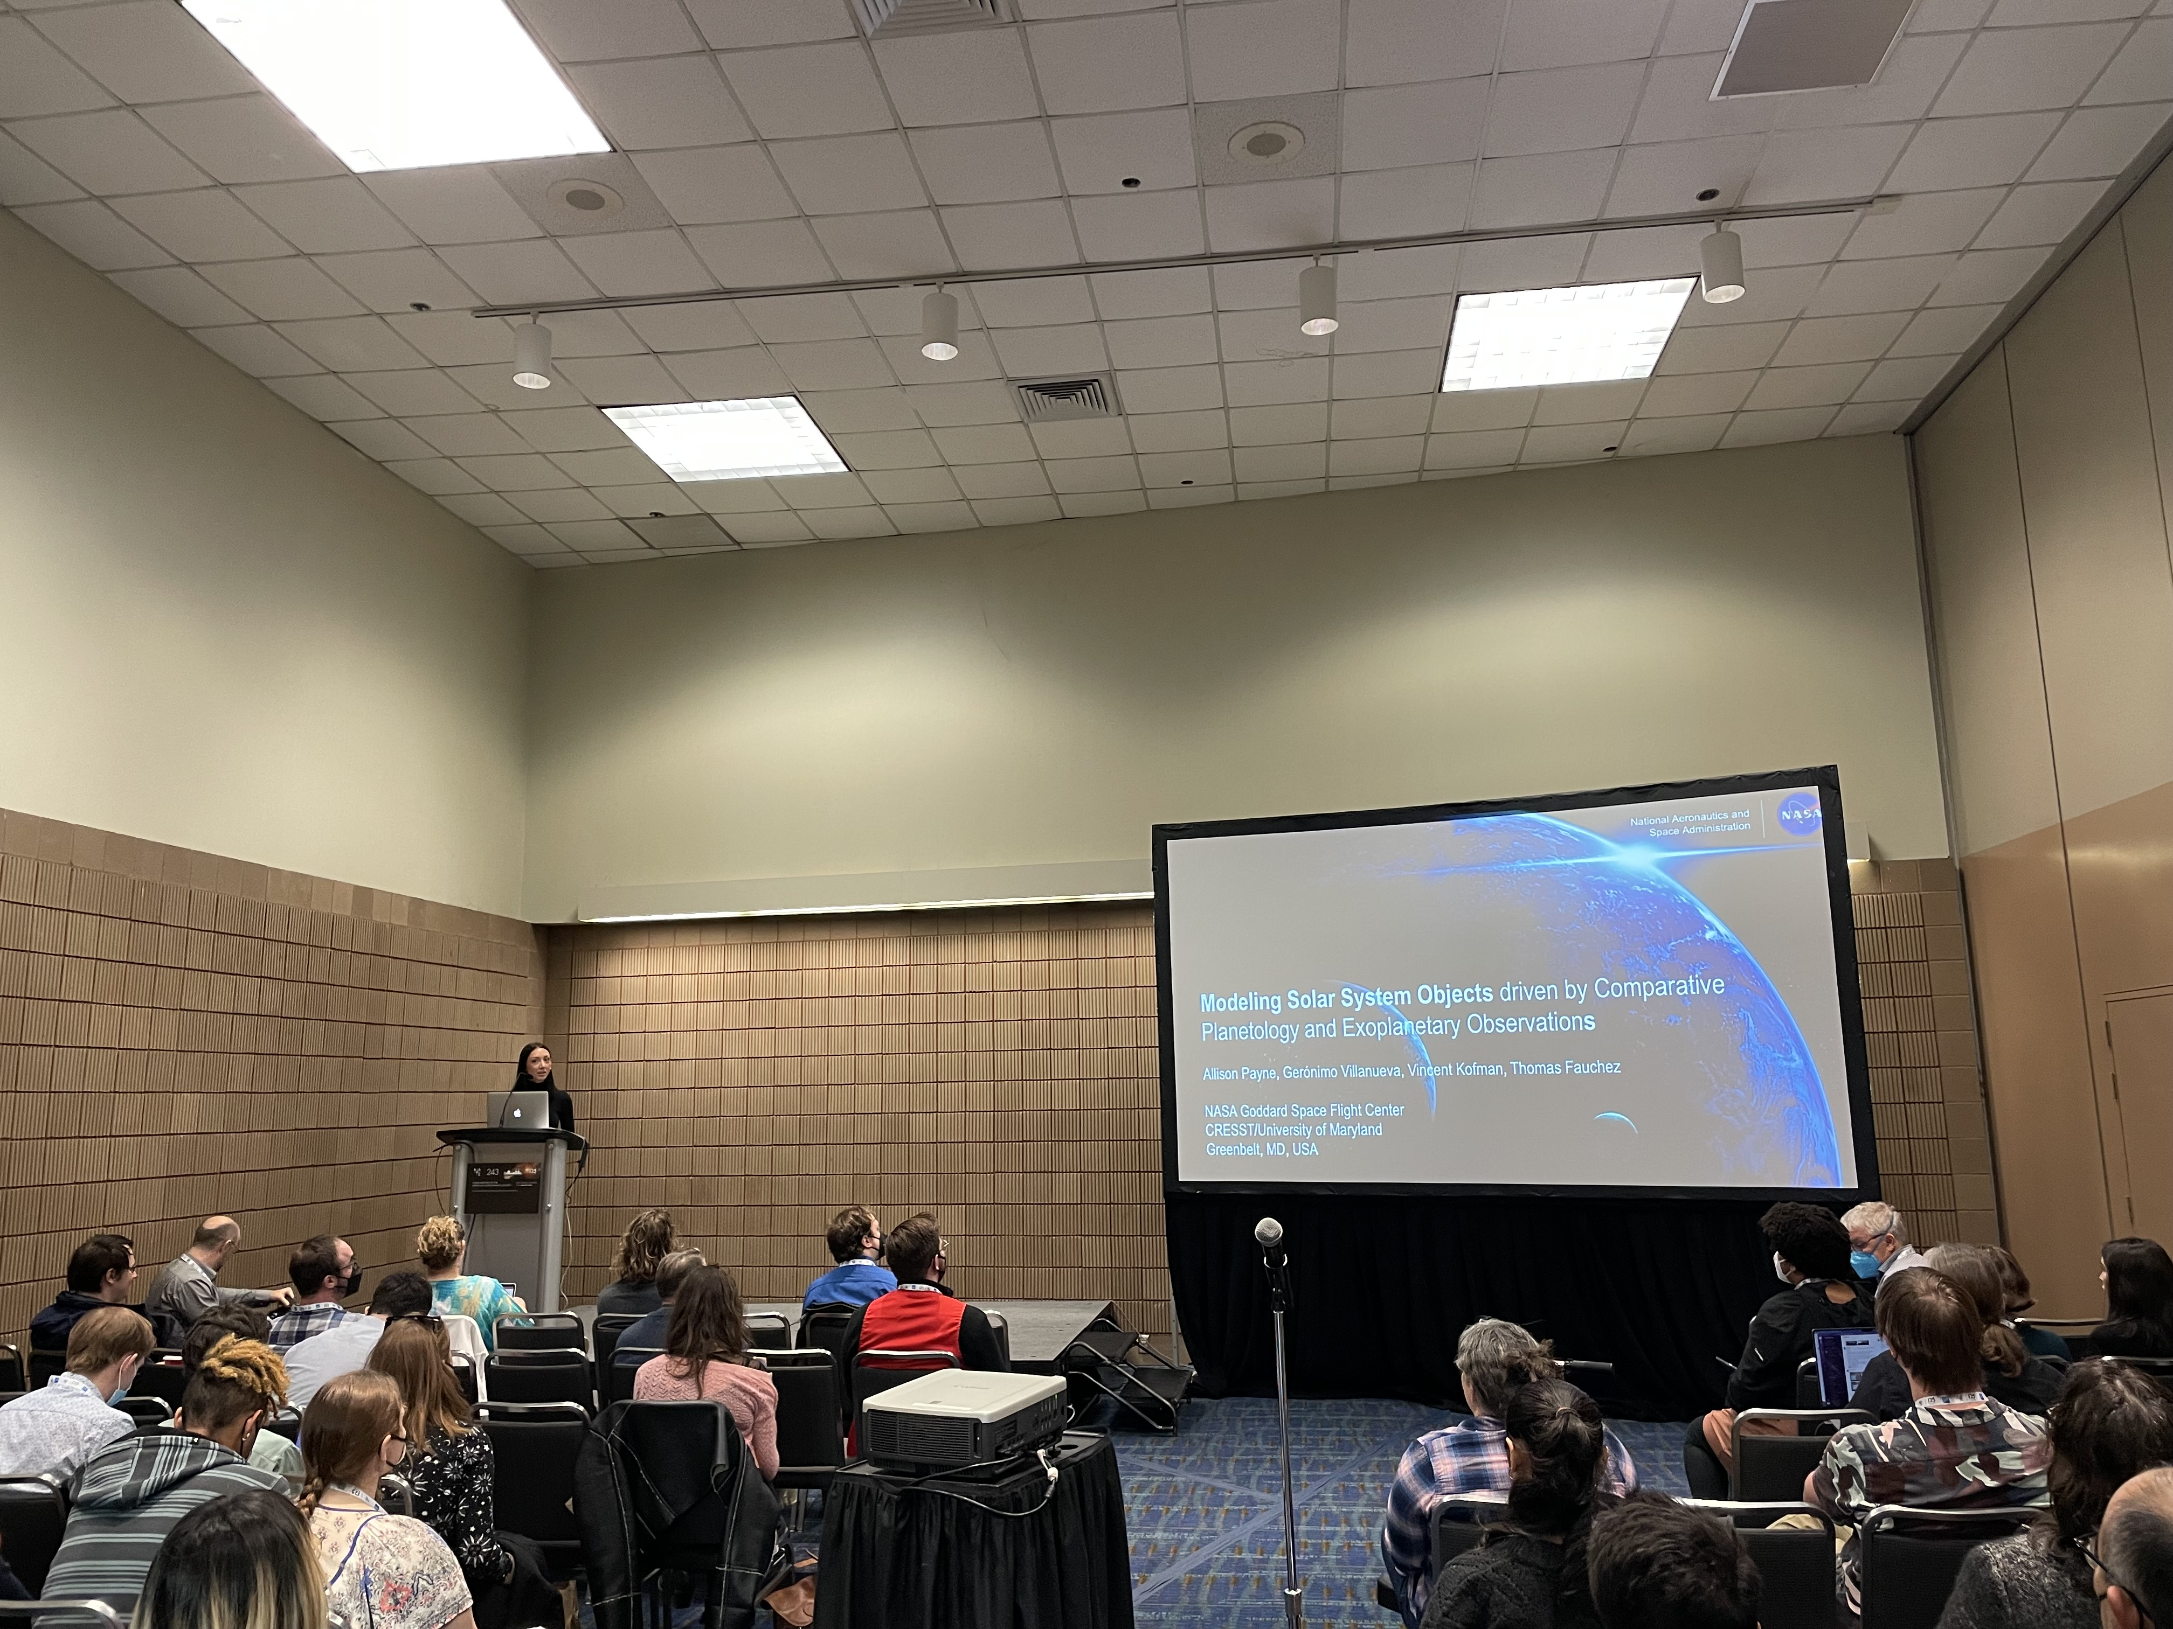
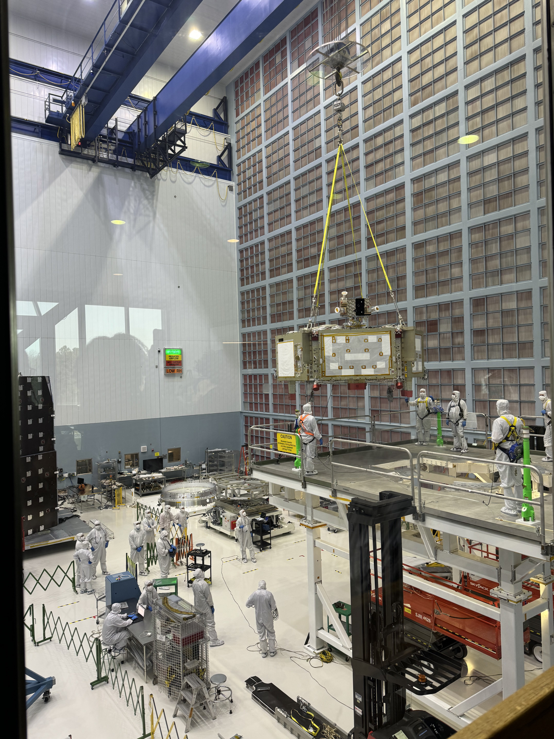
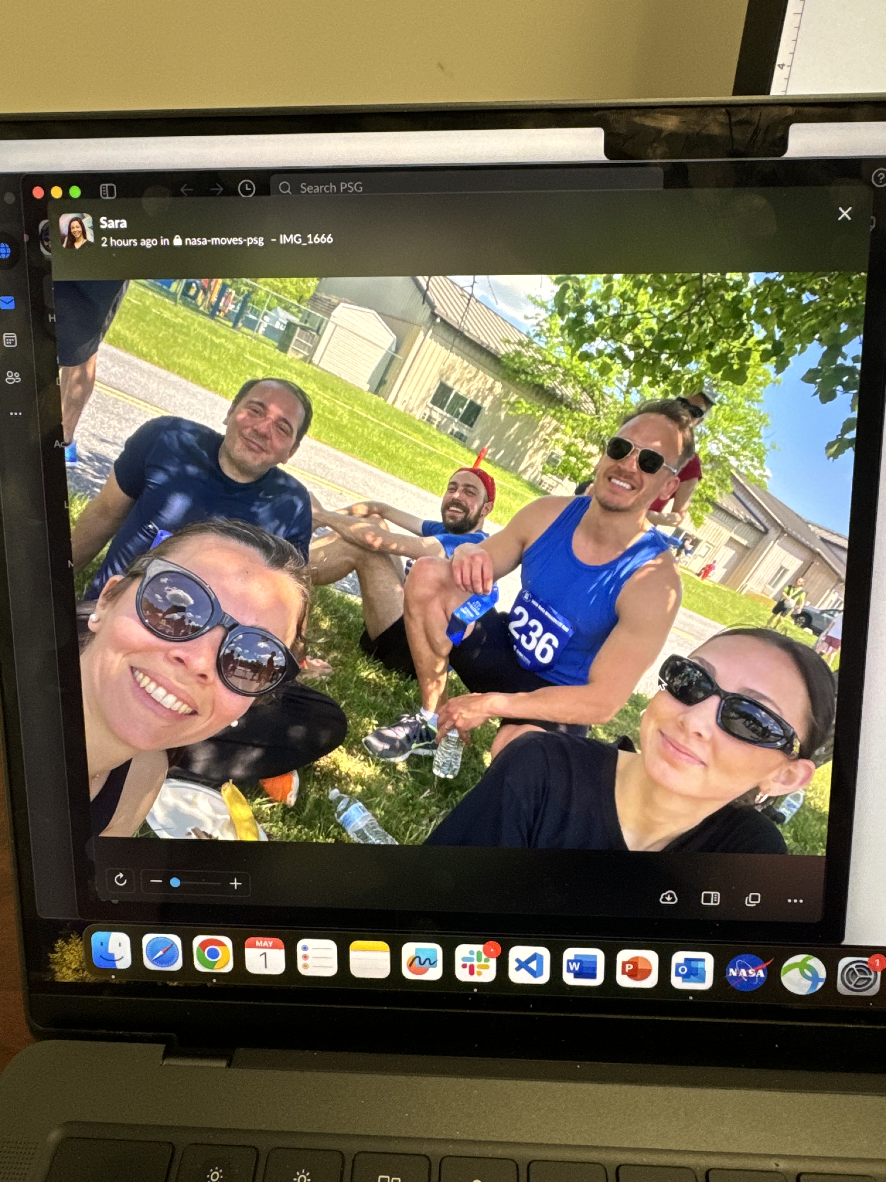

Slide 7
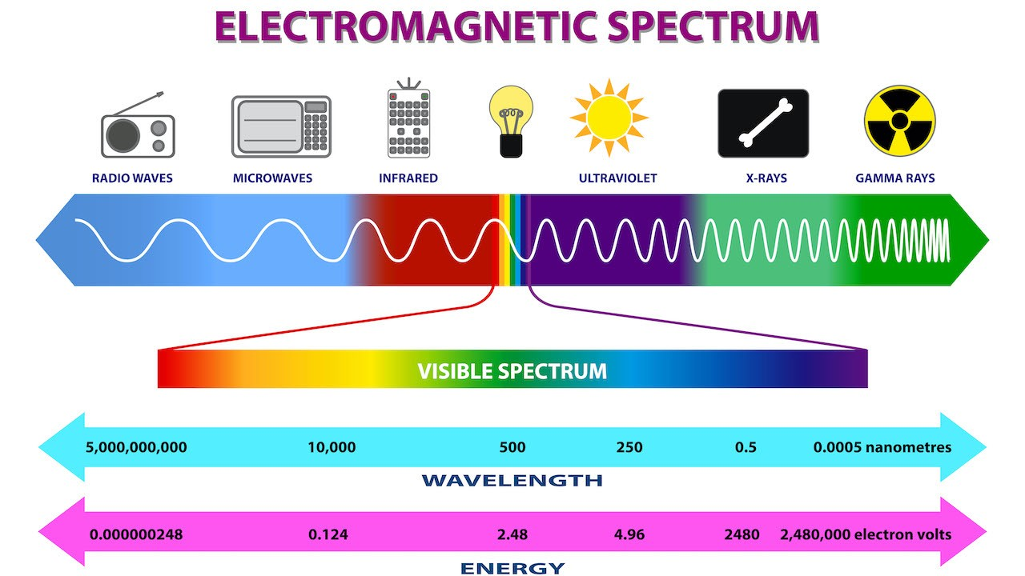
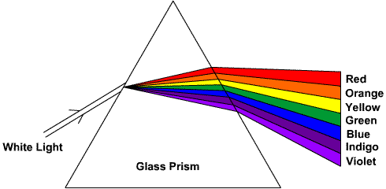
Introducing the EM Spectrum

Slide 8
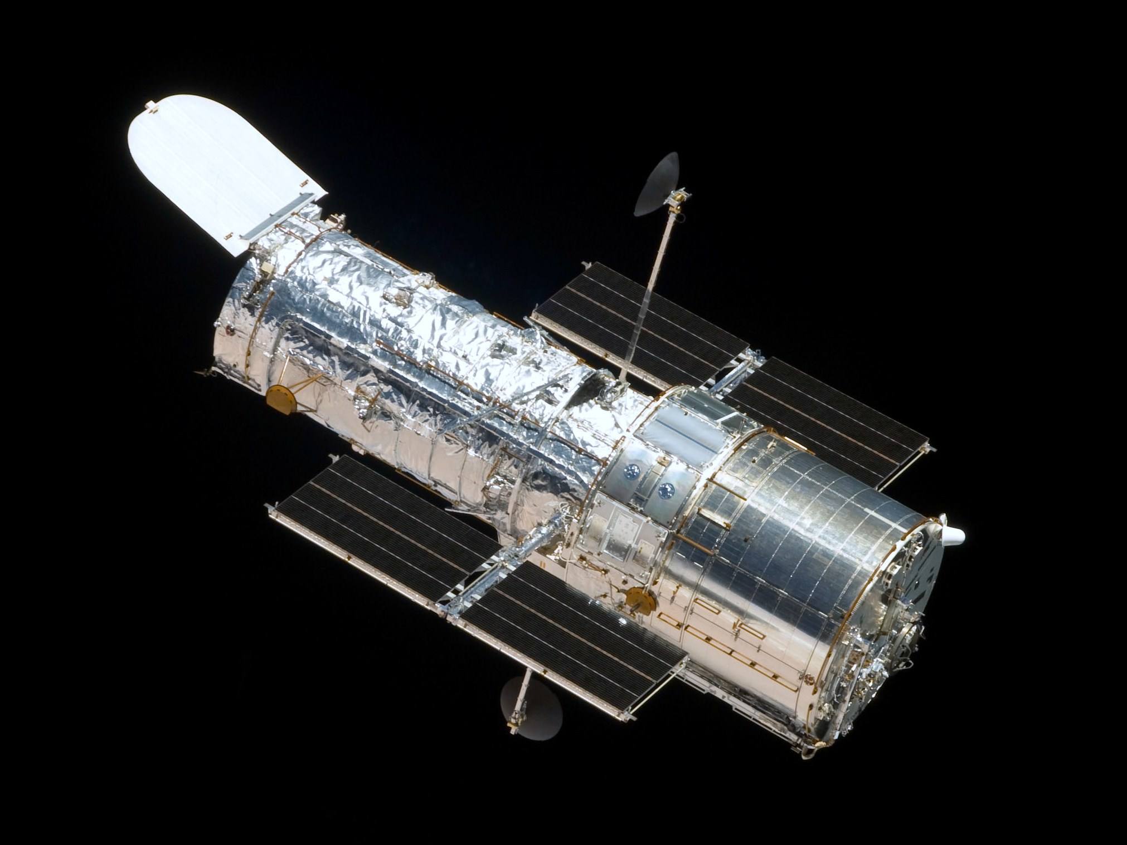
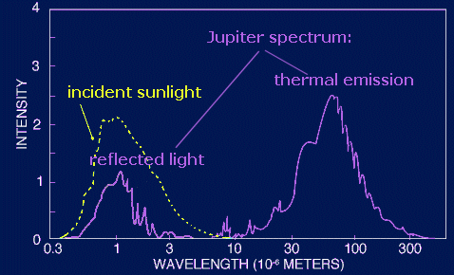
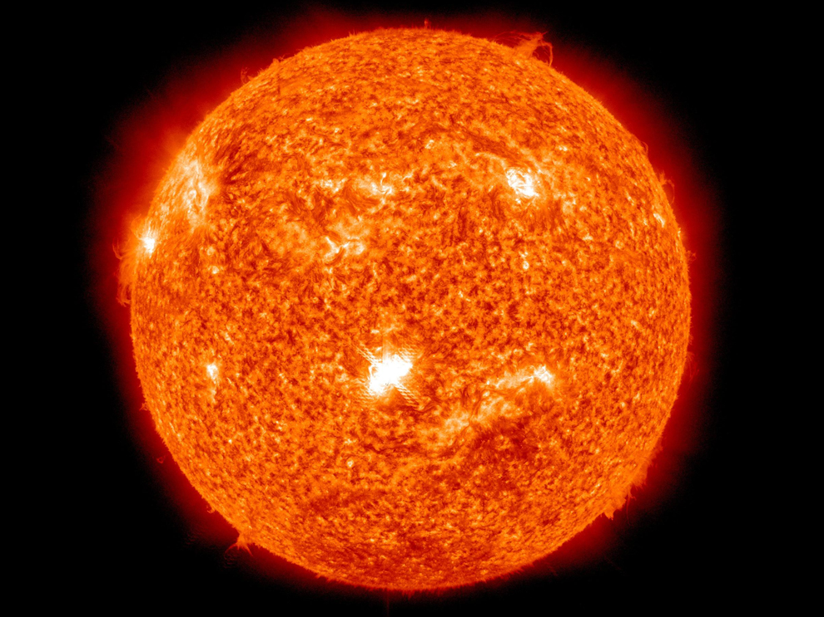
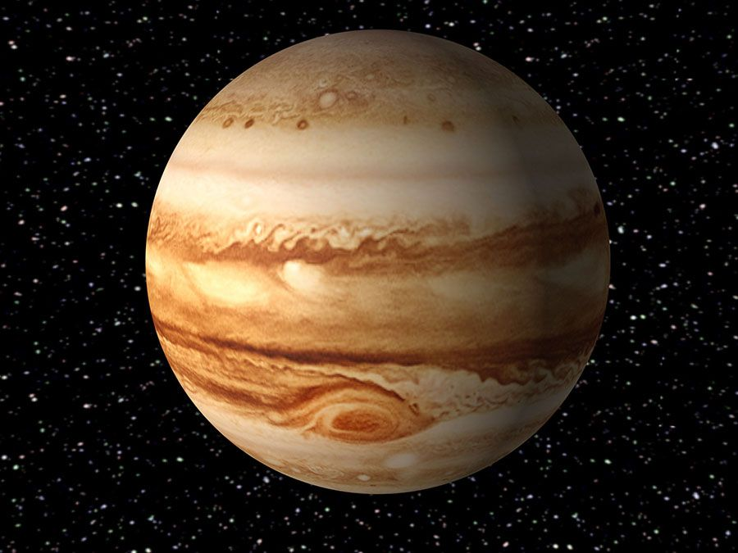
Reflection Spectroscopy

Slide 9
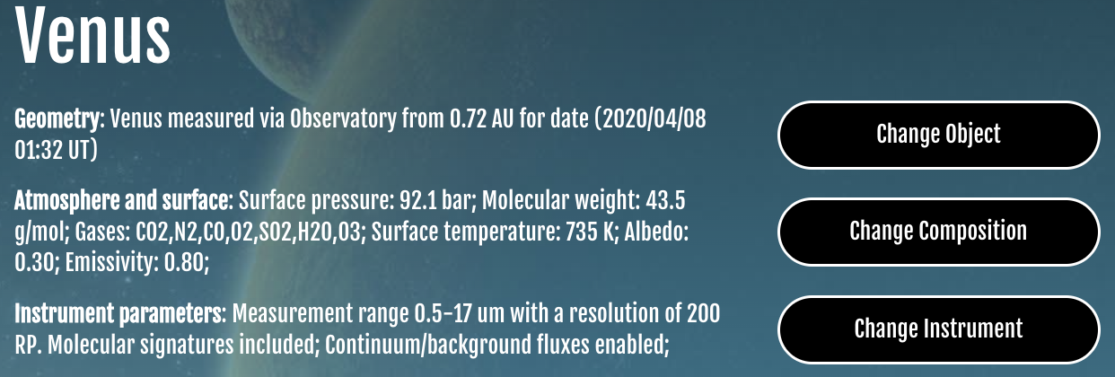

Modeling with the Planetary Spectrum Generator

